Slide 1

Artificial Intelligence
2 Intelligent Agents
Russell & Norvig, AI: A Modern Approach, 3rd Ed
Lec Zinia Sultana
CSE Dept, MIST

Slide 2


Slide 3
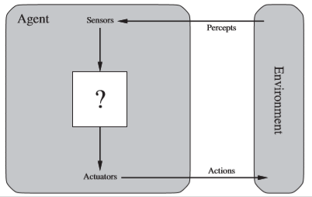
Agent
An agent is
perceiving its environment through sensors
acting upon that environment through actuators.

Slide 4

Agent . . .
Sensors: Cameras, infrared range finder Actuator: Motors |  | Sensor: Eye, ear, . . . Actuator: Hands, legs, mouth, …

Slide 5

Agent . . .
Sensors: keystrokes, ﬁle contents, and network packets.
Actuator: displaying on the screen, writing ﬁles, and sending network packets.

Slide 6
Agent . . .
An agent’s choice of action at any given instant depends on the entire percept sequence observed to date.
Percept refers to the agent’s perceptual inputs at any given instant.
An agent’s percept sequence is the complete history of everything the agent has ever perceived.

Slide 7
Agent Function and Program
An agent’s behavior is described by the agent function that maps any given percept sequence to an action. The agent function is an abstract mathematical description.
The agent function for an artiﬁcial agent will be implemented by an agent program. the agent program is a concrete implementation, running within some physical system.

Slide 8
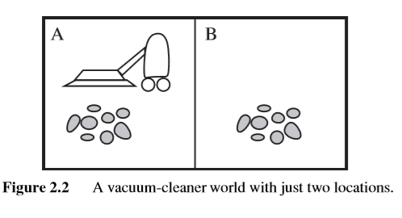
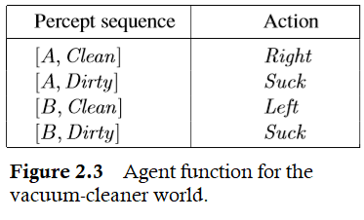
Agent Function and Program . . .

Slide 9
Concept of Rationality
A rational agent is one that does the right thing.
what does it mean to do the right thing? (Road Crossing)
Right thing or action means that action will cause the agent to be the most successful.
This notion of desirability is captured by a performance measure that evaluates any given sequence of environment states.
sequence of actions causes the environment to go through a sequence of states

Slide 10
Concept of Rationality …
Performance Measure:
(single eight-hour shift)
Amount of dirt cleaned
Having a clean ﬂoor for long time
Average cleanliness over time

Slide 11
Dependence of Rationality
Rationality depends on –
Performance measure for the criterion of success.
Agent’s prior knowledge of the environment.
Performable actions.
Percept sequence to date.

Slide 12
Rational Agent
For each possible percept sequence, a rational agent should select an action that is expected to maximize its performance measure, given the evidence provided by the percept sequence and whatever built-in knowledge the agent has.

Slide 13
Omniscience & Autonomy
Omniscience - An omniscient agent knows the actual outcome of actions.
Rationality is not the same as perfection. (Tree Shade example)
Rationality maximizes expected performance
Perfection maximizes actual performance.
Autonomy – Agent may rely on the prior knowledge of its designer (Vacuum cleaner learns where dirt may appear)

Slide 14
Task Environment
Task environments consists of:
The performance measure
The environment
The agent’s actuators
Sensors
PEAS (Performance, Environment, Actuators, Sensors)

Slide 15
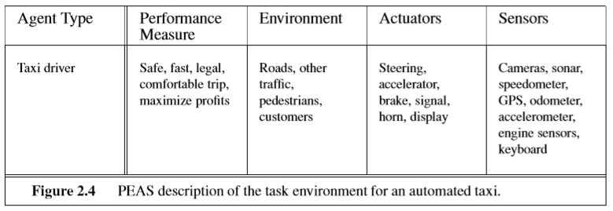
Task Environment …

Slide 16
Task Environment …
Medical diagnosis system
Satellite image analysis system
Part-picking robot
Reﬁnery controller
Interactive English tutor

Slide 17
Properties of Task Environment
Fully observable vs. partially observable (Chess Vs Automated Taxi)
Single agent vs. multi-agent (Crossword Vs Chess)
Deterministic vs. stochastic (Chess Vs Automated Taxi)
Episodic vs. sequential (Defect detection agent Vs Automated Taxi)
Static vs. dynamic (Chess Vs Automated Taxi)
Discrete vs. continuous (Chess Vs Automated Taxi)
Known vs. unknown

Slide 19
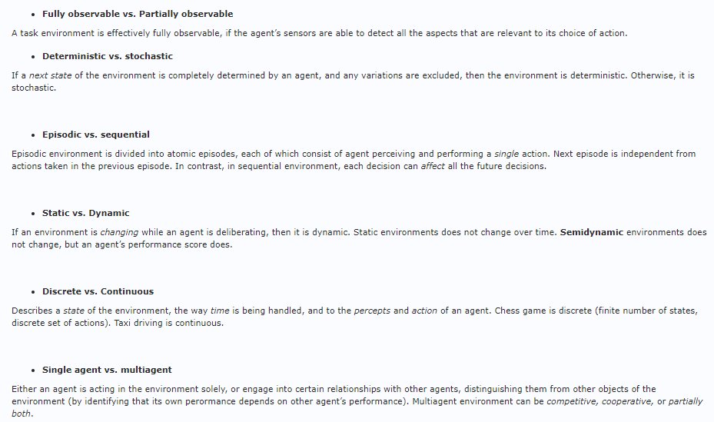

Slide 20
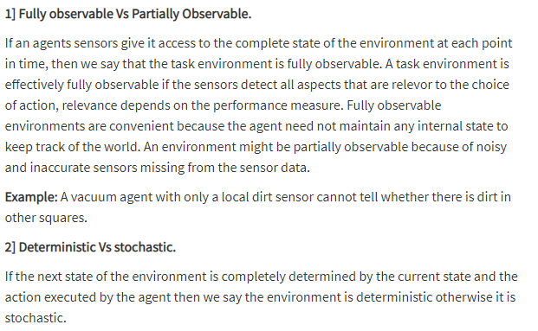

Slide 21
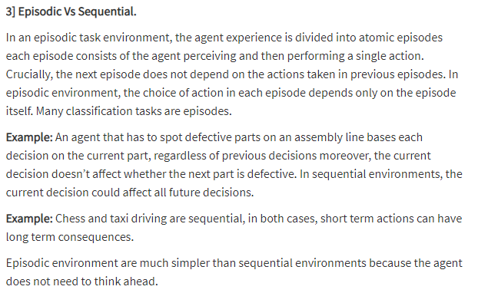

Slide 22
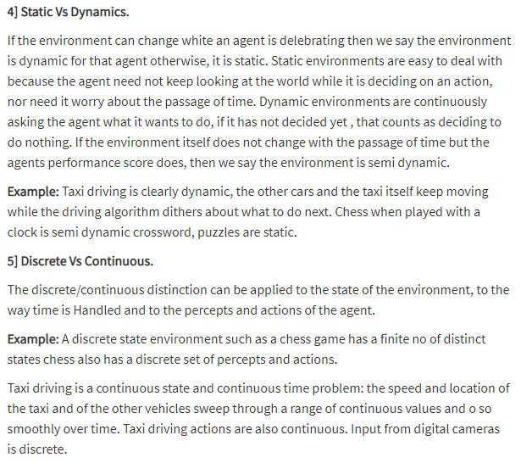

Slide 23
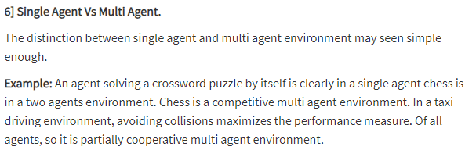

Slide 24
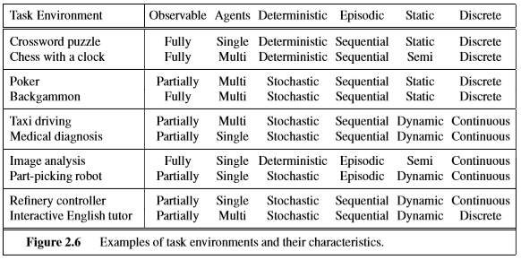
Properties of Task Environment . . .

Slide 25
The Structure of Agents
Table Driven Agent
Simple reﬂex agents
Model-based reﬂex agents
Goal-based agents
Utility-based agents
Learning agents

Slide 26
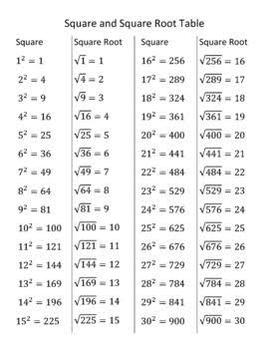
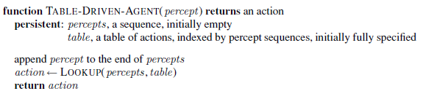
Table Driven Agent
LIKELY CHALLENGES?

Slide 27
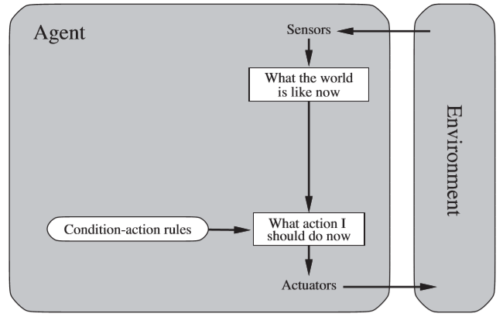
Simple Reﬂex Agent
These agents select actions on the basis of the current percept, ignoring the rest of the percept history.
Condition–action rule

Slide 28
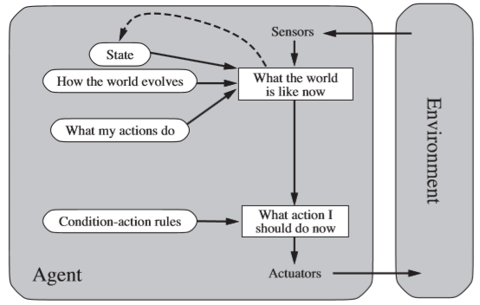
Model-based Reﬂex Agents
These agent should maintain some sort of internal state that depends on the percept history and thereby reﬂects at least some of the unobserved aspects of the current state.
a.k.a Agents with memory

Slide 29
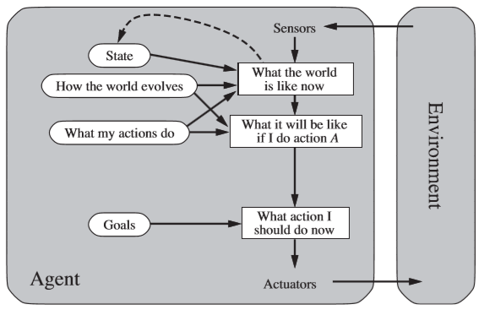
Goal-Based Agents
The agent needs some sort of goal information that describes situations that are desirable.

Slide 30
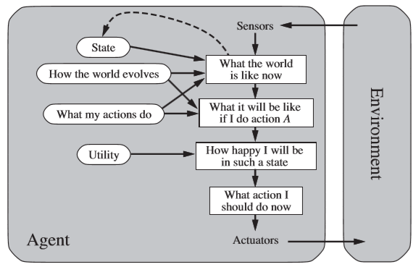
Utility-Based Agents
An agent’s utility function is essentially an internalization of the performance measure. If the internal utility function and the external performance measure are in agreement, then an agent that chooses actions to maximize its utility will be rational according to the external performance measure.

Slide 31
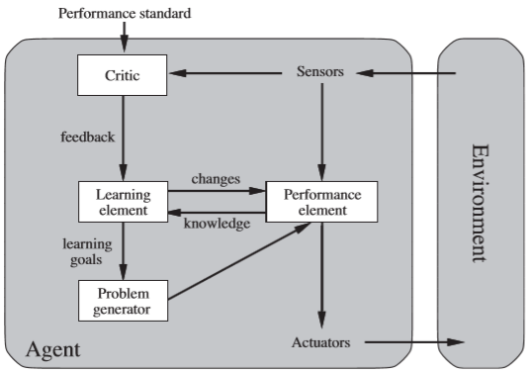
Learning Agents
It allows the agent to operate in initially unknown environments and to become more competent than its initial knowledge alone might allow

Slide 32
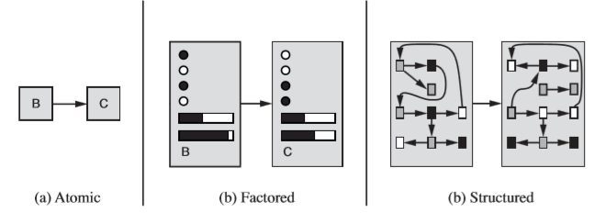
How the components of agent programs work?

Slide 33
Atomic Representation
In an atomic representation each state of the world is indivisible—it has no internal structure.
Search and game-playing
Hidden Markov models
Markov decision processes

Slide 34
Factored Representation
A factored representation splits up each state into a ﬁxed set of variables or attributes, each of which can have a value.
Constraint satisfaction algorithms
Propositional logic
Planning
Bayesian networks
The machine learning algorithms

Slide 35
Structured Representation
Structured representation, in which objects and their various and varying relationships can be described explicitly.
Structured representations underlie relational databases
First-order logic
First-order probability models
Knowledge-based learning
Much of natural language understanding

Slide 36
Thank you ☺

